Slide 1
SEF
IEEE – Software Requirements Specification (SRS)

Slide 2
About Requirements
IEEE Software Requirements Specification
In the last lesson, we learned about
  The reason(s) why we need requirements
  Formalizing and documenting requirements
  Possible ways to gather requirements
  The characteristics of good requirements
In this lesson, we will
  Talk more about the characteristics of requirements
  How the IEEE 830-1998 Specification can help ensure that requirements are documented properly
We will start by examining …

Slide 3
The Life of a Project …
IEEE Software Requirements Specification
The following cartoon illustrates (sadly enough) how some software projects run …
  FYI … The reason that the project may be run this way is not entirely because of lack of requirements and poorly documented requirements … but these definitely contribute!

Slide 4
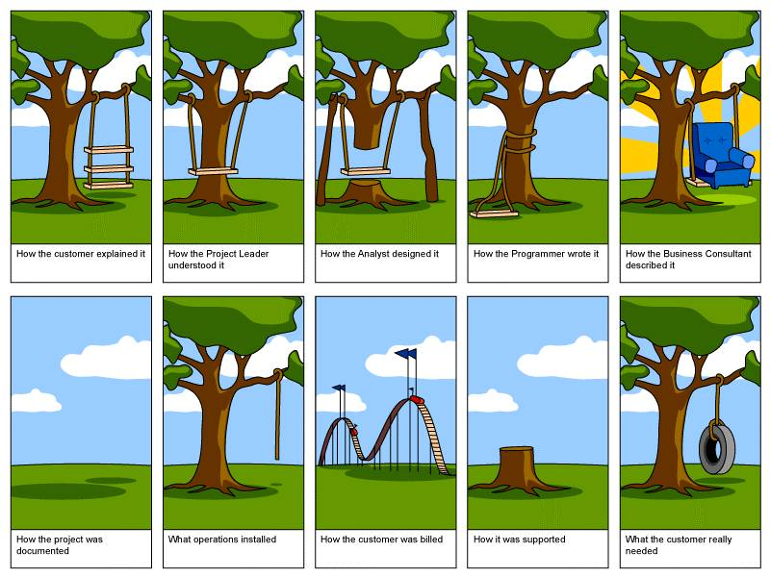
How The Customer Explained It
IEEE Software Requirements Specification

Slide 5
How The Project Leader Understood It
IEEE Software Requirements Specification

Slide 6

How The Analyst Designed It
IEEE Software Requirements Specification

Slide 7

How The Programmer Wrote It
IEEE Software Requirements Specification

Slide 8
How The Business Consultant Described It
IEEE Software Requirements Specification

Slide 9
How The Project Was Documented
IEEE Software Requirements Specification

Slide 10
What Operations Installed the Project
IEEE Software Requirements Specification

Slide 11
How The Customer Was Billed
IEEE Software Requirements Specification

Slide 12

How It Was Supported
IEEE Software Requirements Specification

Slide 13
What The Customer Really Needed
IEEE Software Requirements Specification

Slide 14
What you should take away from this …
IEEE Software Requirements Specification
After viewing that series of cartoon images, you should realize that it takes many people and roles to have a successful and acceptable project
  In this and coming courses – you will learn about these different roles…
  … and you will be given the skills to put on that role hat and do the job correctly and accurately
At this point in your training, you should realize that it is crucial to
  Interact and listen to the customer – to really, truly and honestly understand and gather the requirements for what it is that they need
  Precisely, accurately and completely document these customer requirements so that the project can be a success
These two initial steps set the project on a course for success!

Slide 15
Requirements
Let’s talk
- SRS Characteristics
- IEEE SRS Specification
- A little about Assignment #1

Slide 16
Assignment #1 – Your SRS
IEEE Software Requirements Specification
As we discussed in the previous lesson, in order to avoid
  project chaos
  development mayhem
  customer dis-satisfaction …
  we need to properly, accurately and correctly document our Software Requirements !
  You will be using the IEEE 830-1998 Standard as a format for this assignment.
Let me take a couple of minutes to review the IEEE Specification with you …

Slide 17
IEEE Standard - Important Parts
IEEE Software Requirements Specification
Many of the following statements are taken directly from the standard.

Slide 18
The Nature of the SRS
IEEE Software Requirements Specification
While writing an SRS, the basic ideas and issues that you must address and capture are :
  Functionality
    What is the software supposed to do?
  External Interfaces
    How does the software interact with people, the system's hardware, other hardware, and other software?
  Performance
    What is the speed, availability, response time, recovery time, etc.?
  Attributes
    What are the portability, correctness, maintainability, security, etc. considerations?
  Design constraints
    Are there any required standards in effects, implementation language, policies for database integrity, resource limits, operating environments, etc.?

Slide 19

Where the SRS is used in the overall Project
IEEE Software Requirements Specification
The SRS plays an important role in the life of a software project and as such, it is very important that the SRS :
  Correctly define all of the software requirements so that anyone reading the document will know exactly
    What the software will do
    What the software won’t do
    How it will operate and in what modes
    What will happen as a user interacts with it
    etc.
  Not describe any design or implementation details
  Not impose additional constraints on the software
In a software project, the SRS forms the cornerstone of understanding of the software product !!

Slide 20
Characteristics of a Good SRS
IEEE Software Requirements Specification
We covered these last lesson, but here they are again:
  Understandable by the End-User
  Non-Prescriptive
  Correct
  Complete
  Concise
  Clear
  Precise
  Unambiguous
  Consistent
  Traceable
  Modifiable
  Verifiable
  Usable during the Maintenance Phase of the SDLC

Slide 21
If this were a Real Project … Prototyping
IEEE Software Requirements Specification
In real projects, it is quite a common technique and practice to construct (somewhat) workable prototypes of the system / program during the requirements gathering phase
This is a useful idea because:
  The customer may be more likely to view the prototype and react to it than to read the SRS
  It displays unanticipated aspects of the system's behaviour
  An SRS based on a prototype tends to undergo less change during development

Slide 22
These are Requirements … beware of Design
IEEE Software Requirements Specification
It has been said that “Every requirement limits design alternatives.”
  Let’s pause to think what this might mean – because it is true
The SRS writer(s) must clearly distinguish between identifying required design constraints and projecting a specific design
  You need to remember that you are documenting what to do, not how to do it !

Slide 23
The Structure of an SRS*
IEEE Software Requirements Specification
Table of Contents
1. Introduction
  1.1 Purpose
  1.2 Scope
  1.3 Definitions, Acronyms, and Abbreviations
  1.4 References
  1.5 Overview
* NOTE : These are the sections that will be in your final SRS for Assignment 1

Slide 24
IEEE Software Requirements Specification
2. Overall Description
  2.1 Product Perspective
  2.2 Product Functions
  2.3 User Characteristics
  2.4 Constraints
  2.5 Assumptions and Dependencies
  2.6 Apportioning of Requirements

Slide 25
IEEE Software Requirements Specification
3. Specific Requirements
  3.1 External Interfaces
  3.2 Functions
  3.3 Performance Requirements
  3.4 Logical Database Requirements
  3.5 Design Constraints
  3.6 Software System Attributes
Appendices
Index (not required for this assignment)

Slide 26
Section 1 - Introduction
IEEE Software Requirements Specification
This entire section and all of its subsections are about the SRS itself
  The purpose of the SRS
  Who should read the SRS
  How to read the SRS
  Research and sources used in creating the SRS
  Definition of terms and acronyms used in the SRS
As a result, Section 1 is usually the smallest section in the entire SRS

Slide 27
1.1 - Purpose
IEEE Software Requirements Specification
Should:
  Delineate (or tell) the purpose of the SRS
    Why is this document being written ? Should mention the system / product being documented and perhaps a brief description of why this system needs to be created.
  Specify the intended audience for the SRS
    Who should be reading this document ? Executives, customers, product managers, developers, etc. ?

Slide 28
1.2 - Scope
IEEE Software Requirements Specification
Should:
  Identify the product to be produced by name
  Brief explanation what the product will and, if necessary, will not do
  Describe the application of the software being specified, including relevant benefits, objectives, and goals
  Be consistent with similar statements in higher-level specifications if they exist
  NOTE The descriptions and explanations in this section should be fairly high level and not get into too many specifics

Slide 29
1.3 - Definitions, etc.
IEEE Software Requirements Specification
Define all terms, acronyms and abbreviations found within the SRS
  Not all of the document’s audience are technical people and may not know exactly what every acronym or term means
  Including this section makes the document more readable by a wider audience

Slide 30
1.4 - References
IEEE Software Requirements Specification
Should:
  Provide a complete list of all documents referenced elsewhere in the SRS
  Identify each document by title, report number (if applicable), date, and publishing organization – using the APA standard
  Specify the sources from which the references can be obtained

Slide 31
1.5 - Overview
IEEE Software Requirements Specification
Should:
  Describe what the rest of the SRS contains
  Explain how the SRS is organized
  Tell the reader what will be found in Sections 2 and 3 of the SRS and how they are laid out – perhaps even the intended audience for each of the sections … you are trying to tell the audience what and how to read the rest of the SRS

Slide 32
Section 2 – Overall Description
IEEE Software Requirements Specification
This section of the SRS should describe the general factors that affect the product and its requirements
This section does not state specific requirements
  Instead, it provides a background for those requirements, which are defined in detail in Section 3 of the SRS, and makes them easier to understand
Think of Section 2 as a high-level overview when it comes to defining the functionality and purpose of the software

Slide 33
2.1 - Product Perspective
IEEE Software Requirements Specification
Should put the product into perspective with other related products
  If the software being defined and specified is part of a larger system – then make sure to say this here. Also talk about the larger system and give references to documents about it
  If the software being defined is self-contained then this should be stated here
It can be beneficial to include a block (CONTEXT) diagram of the system showing the major components, the interconnections and the external interfaces

Slide 34
IEEE Software Requirements Specification
This subsection should also describe how the software operates and interacts with the world around it by describing :
  2.1.1 System Interfaces
    Does the software call upon other unrelated systems to perform some function ?
    Name each external system and describe how / what the software does and needs that system to do for it
  2.1.2 User Interfaces
    The logical characteristics of each UI between the software and the user
      This can include descriptions of the required screen formats, page or window layouts, contents of reports and menus, use of special buttons and function keys
      Often times rather than describing all of this content in words it is much more preferable (from the writer’s and the reader’s standpoint) to include UI mock-ups here
    A list of considerations to think about for the UI from the user’s perspective

Slide 35
IEEE Software Requirements Specification
  2.1.3 Hardware Interfaces
    Describe how the software interfaces with the hardware within the system. If the software directly manipulates the hardware then it needs to be described here
  2.1.4 Software Interfaces
    Describe how the software product will interface with other required software products or other applications
      Does the software have a need to call upon a database? directly manipulate and use the O/S? use a supporting mathematical software package? talk to the system hardware through an API?
    Detail the purpose for interfacing with this other software
    Specify the name of software being interfaced to, its version, where it comes from and make reference to any documentation specifying the interface
  2.1.5 Communications Interfaces
    Does the software directly use any underlying communication protocol ? If so, you need to specify that protocol here.

Slide 36
IEEE Software Requirements Specification
  2.1.6 Memory Constraints
    This is where you state your considerations and expectations / limits on memory for the software ?
    Is amount of memory used a concern for the software ? Is memory limited within the system – state it here.
  2.1.7 Operations
    List and describe the various modes of operation of the software here
      e.g. user set-up mode, administration mode, general operation mode, etc.
      Can the software operate in unattended mode ?
      If applicable also make note of the backup and recovery operations of the software
    Note that sometimes this subsection is combined with User Interfaces
  2.1.8 Site Adaptation Requirements
    This section describes any customization that needs to be done or considered when the software is installed at a location
      Is there any setup or configuration that is necessary when installing?

Slide 37
2.2 - Product Functions
IEEE Software Requirements Specification
This section should provide a summary of the major functions that the software will perform
  Do not go into too much detail and do not provide any specific requirements … this section is really a “Reader’s Digest” version of the software’s functionality
  Remember the intended purpose and audience for Section 2 of the SRS
    Either generally a non-technical person or the section provides an introduction to low-level details and requirements of Section 3
    Again diagrams are sometimes helpful in displaying the functions of the software and how they interact

Slide 38
2.3 - User Characteristics
IEEE Software Requirements Specification
In this section you need to describe what expectations the system and software has on its users in terms of their :
  Level of training and experience
  Education
  Technical expertise and/or background

Slide 39
2.4 - Constraints
IEEE Software Requirements Specification
General description of any other items that will limit the architect’s and developer's options. For example:
  Regulatory policies
  Hardware limitations
  Interfaces to other applications
  Parallel operation
  Audit functions
  Control functions
  Higher-order language requirements
  Signal handshake protocols
  Reliability requirements
  Criticality of the application
  Safety and security considerations
In this section, you list and describe any considerations that must be taken into account when architecting and designing the software

Slide 40
2.5 - Assumptions and Dependencies
IEEE Software Requirements Specification
In this section, you list and describe and factors that may affect requirements stated in the SRS
  For example, if an assumption that a specific Operating System will be available on the hardware and it ends up not to be the case, then this would affect the contents of the SRS
Basically what you are trying to capture in this section are any known external considerations that are being assumed in the writing of the requirements for the software
  And if these assumptions end up changing – then the software’s requirements may need to change as well
In essence, this section is used to list and describe the potential risks that the successful completion of the project has …

Slide 41
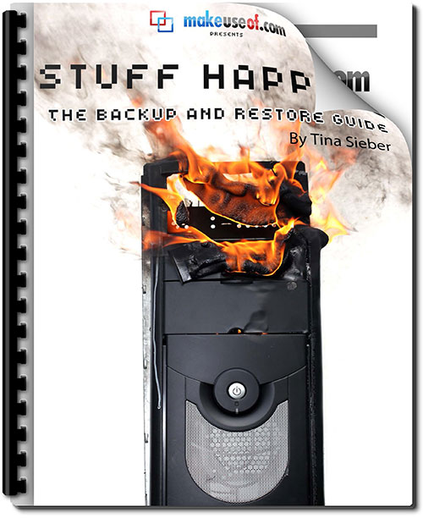
A Note about TBD’s
IEEE Software Requirements Specification
What’s a TBD ?
Strictly speaking according to the IEEE Specification, in order to be a complete SRS – there must not be any TBD’s in the document.
But as we know, stuff happens and as a
result, the software that we are trying to
describe may (at the time of writing the
SRS) have unknowns or assumptions
that need to be made …
  In this case we need to document the TBD
  fully (more on this in another lesson)

Slide 42
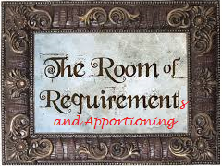
2.6 - Apportioning of Requirements
IEEE Software Requirements Specification
What does Apportioning mean ?!?
  Apportioning means the “putting off of”
So in terms of the SRS – this means that you need to identify requirements that may be delayed until future versions of the system
  If there is a known requirement that has been mentioned and at the time of writing the SRS, you know that it will be put off until a future release, then document it here

Slide 43
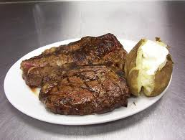
Section 3 - Specific Requirements
IEEE Software Requirements Specification
This section contains all of the requirements to a level of detail sufficient to enable:
  designers to design a system to satisfy those requirements
  testers to test that the system satisfies those requirements
Also remember to follow these principles
  All requirements should be uniquely identifiable (and traceable)
  Attention should be paid to organizing the requirements for maximum readability and comprehension
Other things to consider in documenting your requirements … they:
  Should describe each input (stimulus) to the system.
  Should describe each output (response) from the system.
  Should describe all functions performed by the system in response to an input or in support of an output.
This is where the meat and potatoes of the SRS is found.
Yum!!!

Slide 44
Types of Specific Requirements
IEEE Software Requirements Specification
3.1 External Interfaces
3.2 Functions
3.3 Performance Requirements
3.4 Logical Database Requirements
3.5 Design Constraints
3.6 Software System Attributes
NOTE: There are many different ways of laying out Section 3 – but in all of the different organizations, these subsections need to be present

Slide 45
3.1 - External Interfaces
IEEE Software Requirements Specification
This section should contain a detailed description of all inputs into and outputs from the software.
  It should complement the interface descriptions from Section 2 (in Section 2.1) and be broken out into the same subsections
  For each input or output specified you should specify
    The input / output name
      You will refer to this input / output by name in Section 3.2
    Description of purpose
    Source of input or destination of output
      Where does it come from or where is it going to ?
    Relationships to other inputs / outputs
    The format of the input / output
      Whether that be screen format, window format, data format or command format

Slide 46
3.2 - Functions
IEEE Software Requirements Specification
This is the section of the SRS where all of the software’s requirements are specified !
  This section contains the software’s functional requirements
  This section describes the fundamental actions that must take place in the software in processing the inputs and generating outputs
  Requirements are specified as the shall statements (“The system shall …”)
  In specifying the requirements remember to include
    validity checks on the inputs
    exact sequence of operations
    responses to abnormal situations
    effect of parameters
    relationships of outputs to inputs
  It may be appropriate to break the functional requirements into sub-functions (or sub-processes)
    Based on logical subsystems of the software, or modes of operation of the software, etc.

Slide 47
3.3 - Performance Requirements
IEEE Software Requirements Specification
This sections lists the static and dynamic numerical requirements placed on the software or on the human interaction with the software
  Examples of static:
    number of users
    amount of information
  Examples of dynamic:
    numbers of transactions to be processed within certain time periods for normal and peak workload conditions
  All requirements given in this section should be stated in measurable terms. For example:
    95% of the transactions shall be processed in less than 1 second.

Slide 48
3.4 - Logical Database Requirements
IEEE Software Requirements Specification
The requirements for any information that is to be placed in a database should be specified here
  Remember that a database is really any collection or organization of data
  The requirements for the database need to include:
    The data entities used in the software and any relationships they have to one another
    The frequency of use of the data
      What subsystems or mode of operation will be accessing and manipulating the data ?
    The data retention requirements
      How long does the data need to stay around (exist) ?

Slide 49
3.5 - Design Constraints
IEEE Software Requirements Specification
Specify design constraints that can be imposed by standards compliance, hardware limitations, etc.
  For example
    If your software must be written in C# you would state it here
    If you had to follow Six Sigma Quality Management in your organization, you would state it here
    If your system only had 1 GByte of RAM, you would state it here

Slide 50
3.6: Software System Attributes
IEEE Software Requirements Specification
There are a number of attributes of a software product that serve as requirements
  These are often referred to as the non-functional requirements
It is important to include these attributes so that their achievement can be objectively verified
These attributes can include :
  According to the IEEE Specification : Reliability, Availability, Security, Maintainability, Portability
  Another common breakdown of these attributes are : Reliability, Availability, Serviceability, Usability and Installability

Slide 51
Organizing the Specific Requirements
IEEE Software Requirements Specification
Okay, so now you know what (in terms of details) needs to go into Section 3 of the SRS … but how should you organize that section ?
There are many different ways of organizing Section 3 – depending on the software system, some methods are better than others
Different organizational models include:
  System Mode
    When there are different modes of operation within the software
  User class
    When the software behaves differently depending on the type of user
  Objects
    If your software interacts with different objects (eg. Patient Monitoring System interacts with objects : patient, sensors, nurses, room …)
  Features
    If the system has a number of externally desired services

Slide 52
Organizing the Specific Requirements
IEEE Software Requirements Specification
Other organizational models include:
  Stimulus
    Some systems are best organized by describing the requirements on a per stimulus (input) basis
  Response
    Same idea as stimulus, but on a per output (response) basis
  Functional hierarchy
    if all else fails, organize in this way – according to the functional areas of the software
There are templates that are made available for each one of these organizational models of the Specific Requirements
  They are found in Annex (Appendix) A of the IEEE Standard

